Slide 1
Flikit website SEO

Slide 2
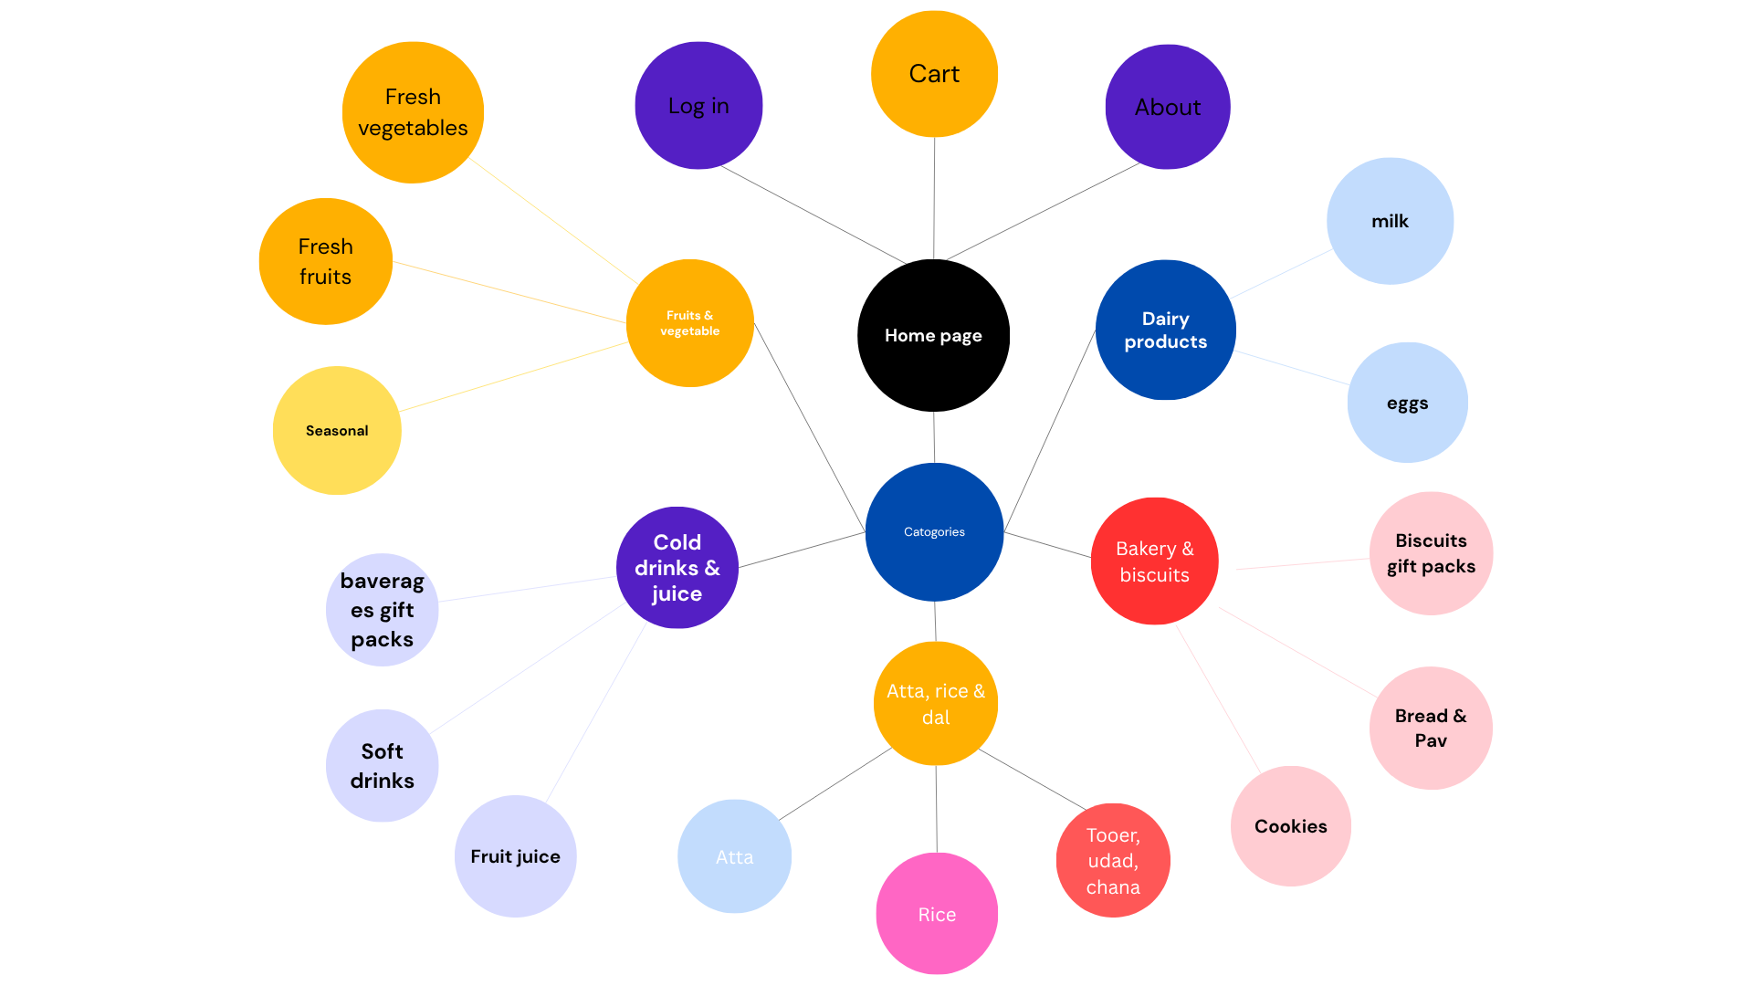
Website structure

Slide 3
Topic ideas for blog pages
1. Life style of flinkit workers.
2. Latest technology.
3. News about the world(What is happening in the world at the time).
4. Sports related content.
5. DIY content (Like how to make a restaurant like recipe at home).
6. Content about seasonal Festivals like Diwali, christmas etc.
7. Content about political issues.
8. Informational blog like “what is Data science?”
9. Corporate life of flinkit employee.
10. Content about beginner’s guid.

Slide 4
Topic ideas for product page
1. Amul gold milk online.
2. Grocery item online.
3. Fruit juice online delivery.
4. Buy Dairy milk silk.
5. Buy nescafe coffee.
6. Buy kurkure solid masti.
7. Head & shoulders shampoo online.
8. Amul salted butter online.
9. Buy sprite online.
10. Amul masti dahi in 10 minutes.

Slide 5
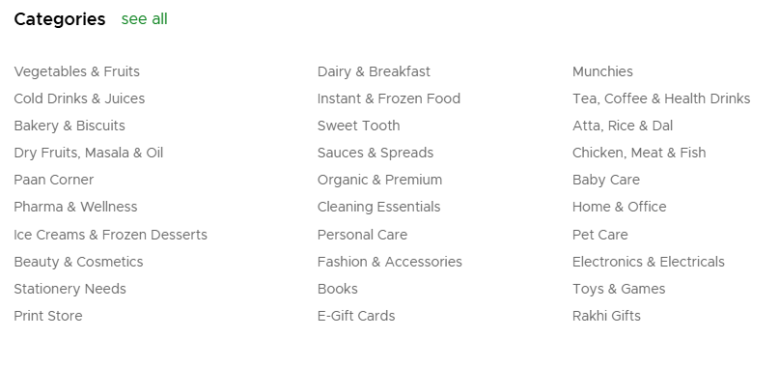
Topic ideas for category page

Slide 6
Content structure for a blog.
1. H1:- Title of the blog(it should be catchy and of 50 to 60 characters) and also contain the primary keyword.
2. Introduction should be within 150-160 characters and include the primary keyword too. It should be user friendly.
3. Use H2 for the main content of your blog, like in H2 write the subheading of the topic, then explain the topic within the character range of 150-160, include the primary keyword with the KD 0.2, provide examples, analysis and insert the appropriate images to the appropriate places to make the user understand more.
4. End your blog by adding H2 with conclusion and main points of your blog.
5. Use FAQs for the reader.

Slide 7
Content structure for product page.
1. Use H1 to include product title with the primary keyword. (Like Iphone 16 pro max)
2. Write description of the product and highlight the benefit of the product as well.
3. Include the images of the products for more understanding. If possible include 360 degree view.
4. Add CTA’s like buy now , add to cart etc.
5. Write the price of the product, if possible show the discount offer too.
6. Use H2 to highlight the key features of the product.
7. Use H2 for the detailed description of the product.
8. Use H2 for the reviews of previous buyers and ratings.
9. Use H3 for shipping, return and warranty info.
10. Add CTA’s like buy now, add to cart etc.(At bottom again)

Slide 8
Content structure for product category page.
1. Use H1 for category page title with the primary keyword. (Ex. watches for man)
2. Use 1-2 short paragraphs to describe the category, include primary keyword, secondary keyword, respective brand’s USP, quality and verity.
3. Use product filters like brand, size, price etc.
4. Use sort options like popularity, new arrival, customer rating etc.
5. Display your products with images, name, short title or key feature, price, star rating.
6. Add CTA’s like buy now or add to cart.
7. Add promotional banners if possible.
8. Add other similar products in the bottom.
9. Add internal links like Watches for man under specific price.

Slide 9
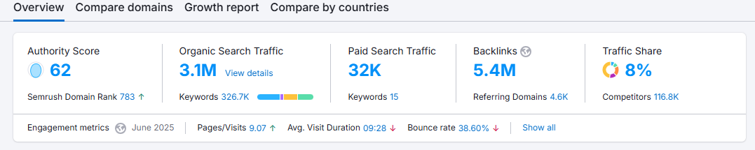
Competitor research for flinkit.
Competitors for flinkit are zapto, blinlkit, big basket.
For blinkit analysis please see the images below.

Slide 10
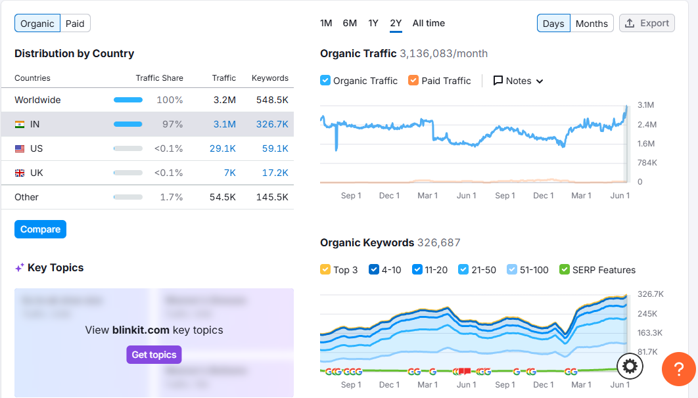

Slide 11
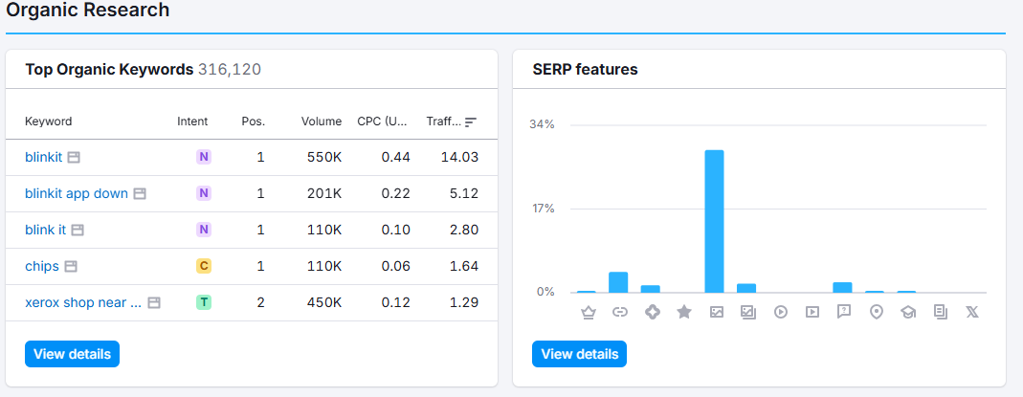

Slide 12
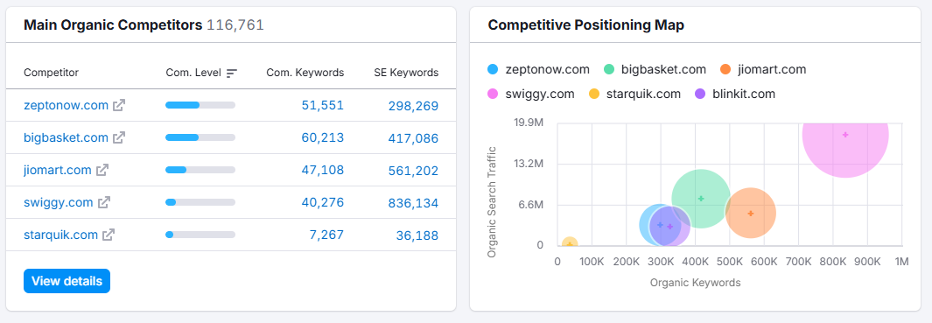

Slide 13
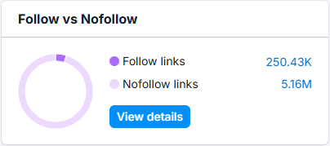
Do follow and no follow backlink for blinkit

Slide 14
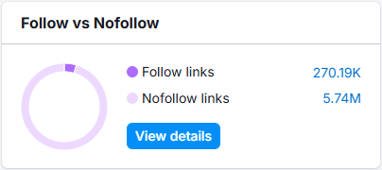
Do follow and No follow backlink for big basket

Slide 15
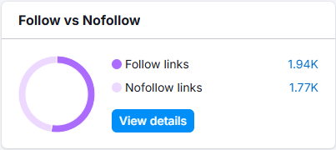
DO follow and No follow backlinks for Zepto

Slide 16
Flinkit is missing these keywords in terms of competitors:-
Earbuds, dragon fruit, 1mg, grocery store near me
Flinkit’s weakness is that our tagline is “Anything will be delivered in 10 minutes” but our competitor Zapto is doing a better job in terms of delivering things in 10 minutes.
Zapto’s top search is groceries like “Kurkure”, “Apple juice”, “Cheese slices”, “Chocolate box”, “Amul milk” etc.
Flinkit is in lack of traffic in these keywords:- mamaearth, mango, indian political maps, rosemary, blueberry.

Slide 17
Keyword research for blog page.
Keyword volume Kd%
Latest technology blog 100-1K 35
New tech trend 1K-10K -
Latest trend in information technology 100-1K 34
Tech new blog 10-100 41
Latest tech blogs 100-1K 40
IOT emerging trends 10-100 25
Latest trend in tech 1K-10k 45
New technological trend 1K-10K 44

Slide 18
Keyword research for product page
Keyword | Volume | DA | PA | KD%
Amul milk gold online | 100-1k | 76 | 30-40 | 8
Kurkure online | 100-1k | 76 | 25-35 | 57
Axe deo online | 100-1k | 76 | 25-35 | 11
Armani shirt online | 100-1k | 76 | 25-30 | -
Zara bags online | 100-1k | 76 | 25-35 | 12
Boat earbuds flipkart | 10o-1k | 76 | 20-30 | -

Slide 19
Keyword | Volume | DA | PA | KD%
Vegetable onine | 1k-10k | 76 | 30-40 | 8
Ashirwad aata online | 1k-10k | 76 | 25-35 | 68
Nike shoes online | 1k-10k | 76 | 25-35 | 51
Titan specs near me | 1k-10k | 76 | 25-30 | 100

Slide 20
Keyword research for product category page
keyword | Volume | DA | PA | KD%
buy vegetables online India | 1k-10k | 76 | 30-40 | 76
organic grocery India | 1k-10k | 76 | 30-40 | 76
grocery snacks online India | 1k-10k | 76 | 25-35 | 76
pantry groceries India | 1k-10k | 76 | 25-35 | 76
buy pulses online India | 1k-10k | 76 | 30-40 | 41

Slide 21
keyword | Volume | DA | PA | KD%
buy spices online India | 1k-10k | 76 | 30-40 | 45
buy rice online India | 1k-10k | 76 | 30-40 | 50
buy flours online India | 1k-10k | 76 | 25-35 | 35
buy organic grains online India | 1k-10k | 76 | 25-35 | 30
buy edible oil online India | 1k-10k | 76 | 30-40 | 55

Slide 22
On page elements.
Meta title:- Everything delivered in minutes
Meta description:- Shop online for groceries and get your order delivered at your doorstep in minutes. Enjoy instant delivery with blinkit
Canonical tag:- https://blinkit.com/
Header Tag(H1-H6):- None
Keywords:- Buy Grocery Online, Online Grocery, Grofers, Groffers, Groferss, blinkit grofers, blinkit, blink it, Grocery Store, Online Grocery Shopping, Online Grocery Store, Online Supermarket, Free Delivery, Great Offers, Best Prices
Internal links:- 46

